Slide 1
Transistors, Operations and It’s Basic Structures.
Presented By:
M. Mureed Baloch and Santosh Kumar Meghwar.

Slide 2
Table of contents
01
02
03
04
Introduction to Transistors
Types Of Transistors
Basic Struture of Transistors
Operations of Transistors

Slide 3
Transistors

Slide 4
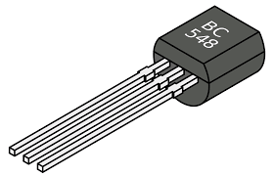
Pictorial Glimps !

Slide 5
What are transistors ?
A transistor is a type of semiconductor device that can be used to conduct and insulate electric current or voltage. A transistor is a miniature device that is used to control or regulate the flow of electronic signals.
A three terminal semiconductor device used for amplification and switching.
Invented by J barden & W. H. Brattain of the Bell Telephone Laboratory USA
Transistor comprises of two words:
Trans = Transfer
istor = Resistor
Which means transfer of resistance

Slide 6
02
Types of Transistors

Slide 7
There are basically two major types of Transistor:
Bipolar Junction Transistor (BJT)
Field Effect Transistor (FET)

Slide 8
Bipolar Junction Transistor (BJT)
This is the original type of transistor and is often referred to as a "normal" transistor. It relies on the flow of both electrons (negatively charged particles) and holes (absence of an electron, acting like a positive charge) for its operation.

Slide 9
BJTs have 2 Main Sub-Types
NPN: The most common type, where the base region is sandwiched between a collector (P-type) and an emitter (N-type) region.
PNP: Less common, with a P-type base region between an N-type collector and emitter.

Slide 10
Field-Effect Transistor (FET):
This type relies on an electric field to control the flow of current. It does not involve the movement of holes.FETs offer high input impedance (resistance) and are generally considered more sensitive than BJTs.

Slide 11
FETs have 2 Main Sub-Types
MOSFET: (Metal Oxide Semiconductor Field Effect Transistor)Uses gate voltage to control conductivity.
JFET(Junction Field Effect Transistor): Controls current flow along the channel with a semiconductor junction.

Slide 12
03
Basic Structure of Transistors

Slide 13
Basic Structure of Transistors
A transistor consists of two PN diodes connected back to back. It has three terminals namely emitter, base and collector. The basic idea behind a transistor is that it lets you control the flow of current through one channel by varying the intensity of a much smaller current that's flowing through a second channel.

Slide 14
Basic Structure of Transistors
Emitter – This segment is on the left side of the transistor. It is moderately sized and heavily doped.
Base – This segment is at the center of the transistor. It is thin and lightly doped.
Collector – This segment is on the right side of the transistor. It is larger than the emitter and is moderately doped

Slide 15
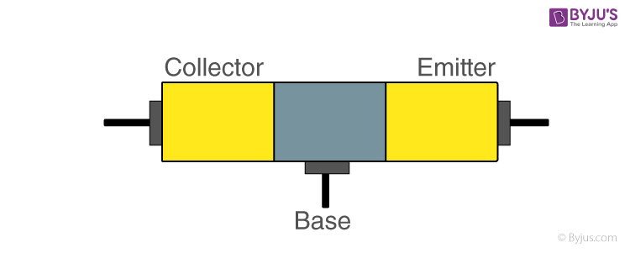
Pictorial Glimps !

Slide 16
04
Operations of Transistors

Slide 17
Operations of Transistors
A transistor can act as a switch or gate for electronic signals, opening and closing an electronic gate many times per second. It ensures the circuit is on if the current is flowing and switched off if it isn't. Transistors are used in complex switching circuits that comprise all modern telecommunications systems.

Slide 18
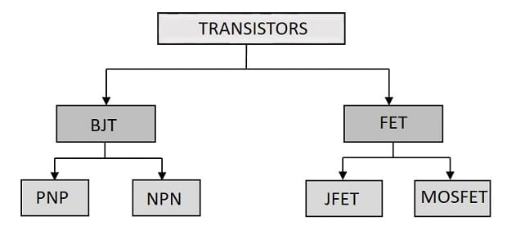
Conclusion !!

Slide 19
Conclusion !!
Transistors are tiny electronic devices that act like switches or amplifiers in electronic circuits. They have three basic structures: the emitter, the base, and the collector. The operation of a transistor relies on the control of current flow between these structures. In conclusion, transistors are essential components in electronics, enabling everything from simple on/off functions to complex signal amplification, making modern technology possible.

Slide 20
Thanks!
Adios!!!

